Slide 1
Q-Learning and Real-Time Strategy
CSCI 8360 Data Science Practicum
Spring 2021

Slide 2
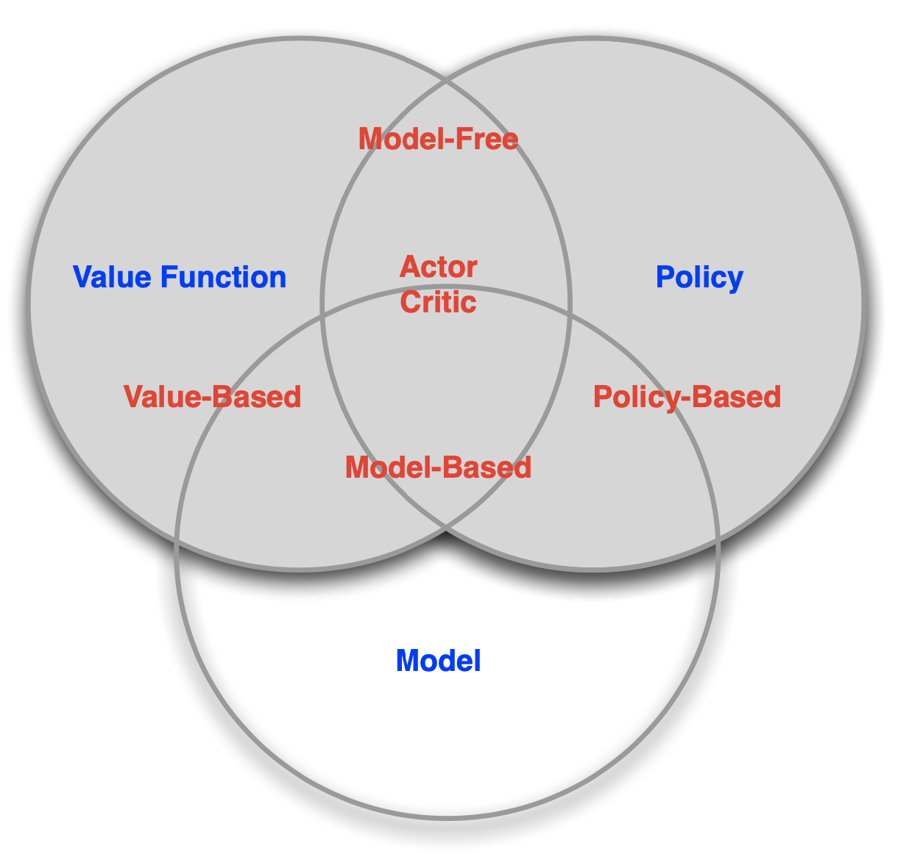
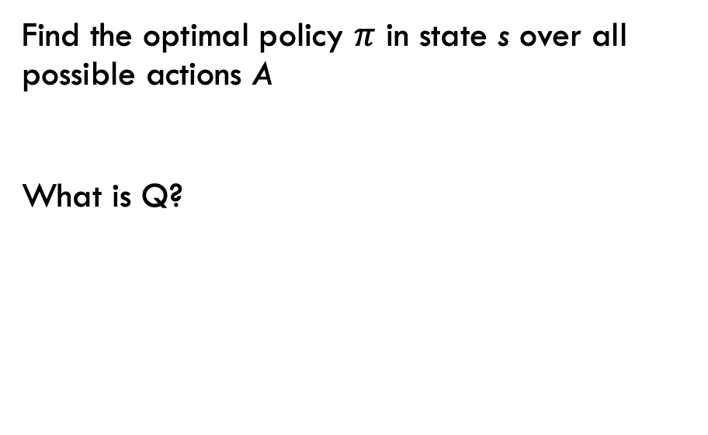
Value-Based Methods for RL
Find the optimal policy $π$ in state s over all possible actions A
What is Q?
Notes:
T: transition function between states (conditional probabilities)
R: reward function
Gamma: discount factor

Slide 3
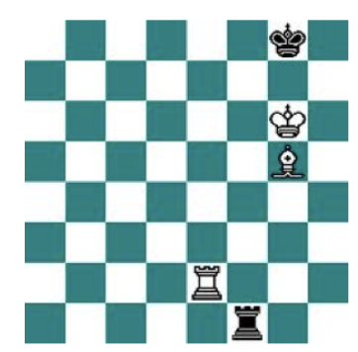
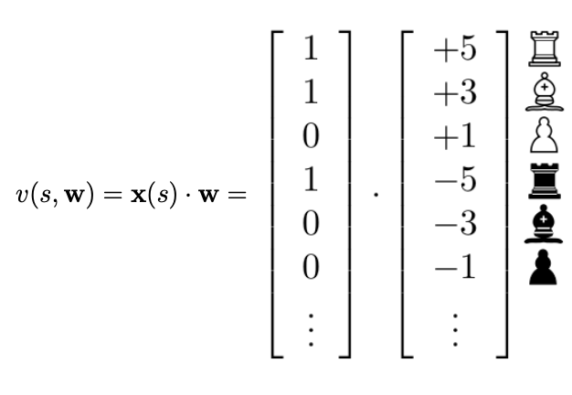
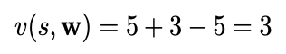
Previously On: The Previous Lecture
Binary-linear value function v(s, w)
Binary feature vector x(s): one feature per chess piece
Weight vector w: value of each chess piece
Position is evaluated by summing weights of current features
Recall: in a fully observable system, state simply becomes observation.

Slide 4
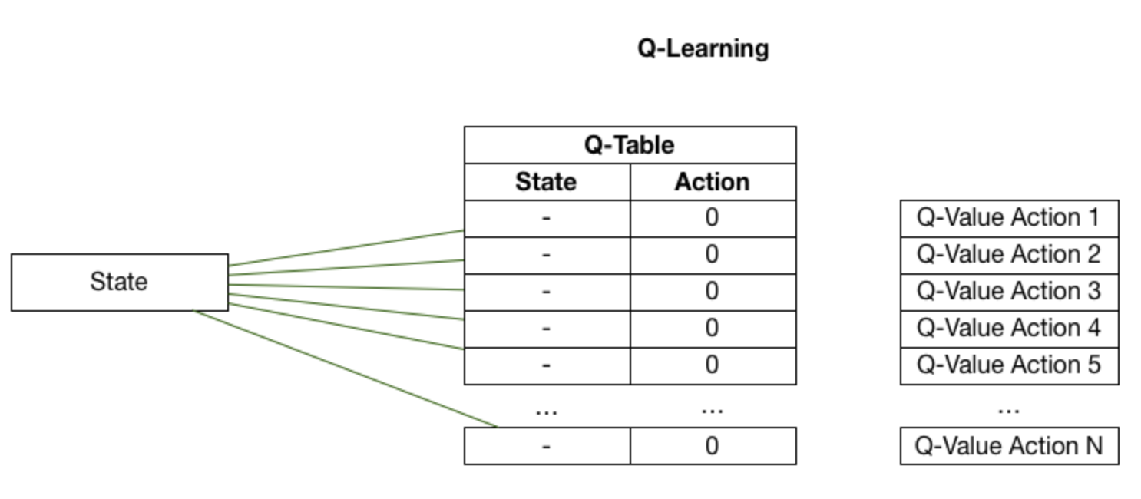
Q-Learning
For the spreadsheet-o-philes
Goal of Q-Learning: build a table mapping all possible states to all subsequent estimates of reward for being in that state

Slide 5
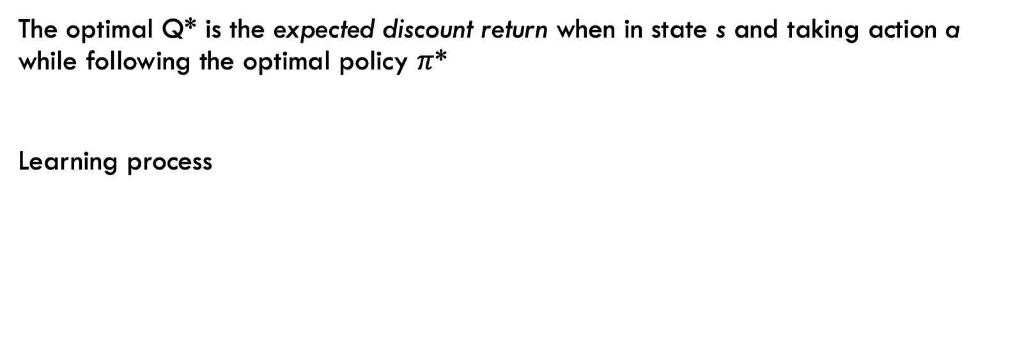
Q-Learning
The optimal Q* is the expected discount return when in state s and taking action a while following the optimal policy $π$*
Learning process
Learning rate
Discount factor
Next training iteration
Current estimate
Reward
Estimate of optimal future value
Current estimate

Slide 6
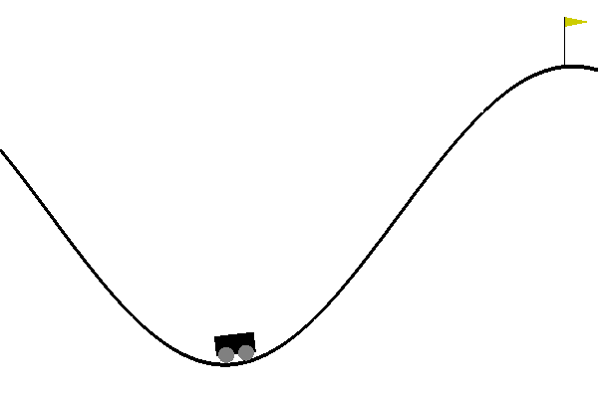
Q-Learning
Example: Mountain Car
Actions
0: apply left force
1: do nothing
2: apply right force
Environment
State[0]: position
State[1]: velocity
Car does not have enough force to climb the hill entirely on its own

Slide 7
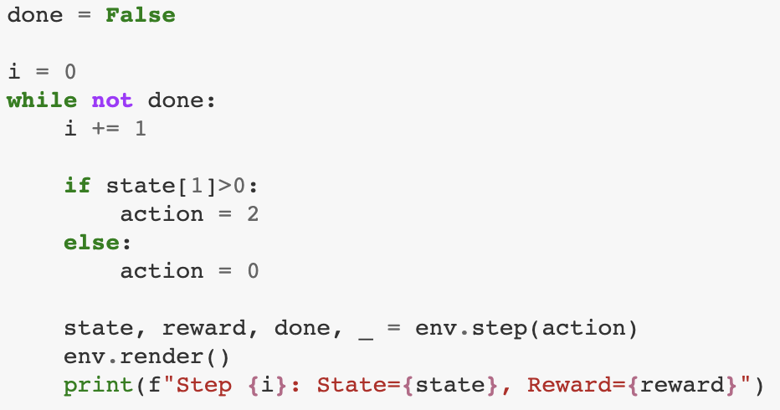
Q-Learning
Example: Mountain Car
You could certainly hard-code this!
If velocity = 0, apply force in a random direction
If velocity > 0, apply force in the direction of movement

Slide 8
Q-Learning
Example: Mountain Car
You could simply hard-code this!
If velocity = 0, apply force in a random direction
If velocity > 0, apply force in the direction of movement

Slide 9
Q-Learning
Example: Mountain Car
…but we’d like something a little more generalizable
Start by discretizing state space
Binning position/velocity
Randomly initialize Q table
Iterate!

Slide 10
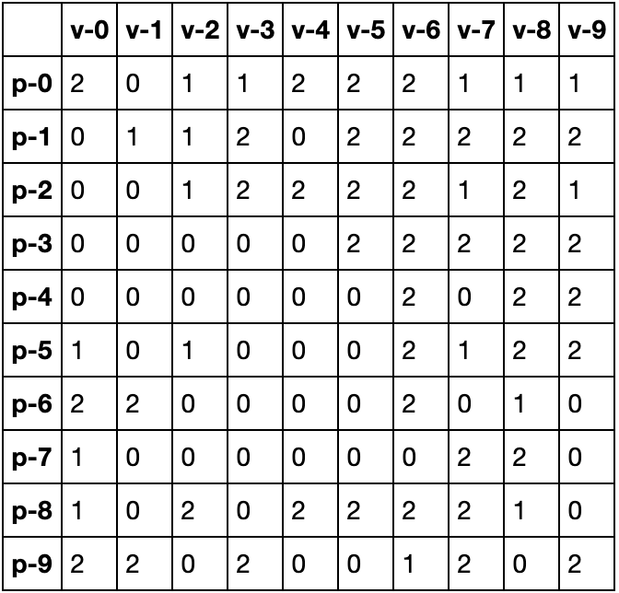
Q-Learning
Example: Mountain Car
We’d get a Q table that looks something like this
Note the discretization of position and velocity into 10 bins
p0 is far left, p9 far right
v0 is not moving, v9 is max velocity (magnitude)
After training, values in the table indicate the action that should be taken in a given state
Yielded the greatest reward in training
0: move left, 1: do nothing, 2: move right

Slide 11
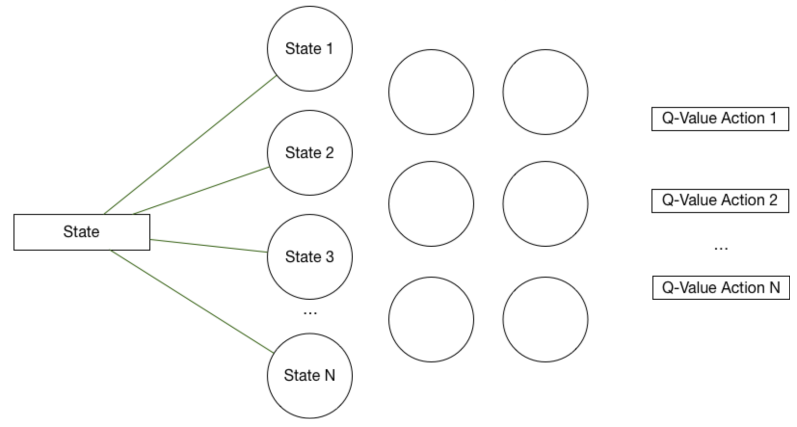
Deep Q-Learning
Uses a deep neural network
Aka, universal function approximator
Also addresses the problem of continuous state values
Input: state
Output: action

Slide 12
Pause For Questions

Slide 13
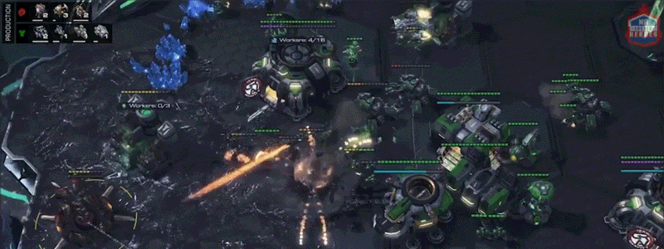
Real-Time Strategy
RL in video games

Slide 14
A few Questions
Have you heard of “real-time strategy” in the context of video games?
Have you heard of StarCraft (or StarCraft II)?

Slide 15
A Few Answers
Real-time Strategy (RTS)
Real-time
As opposed to turn-based
Time moves forward continuously, without human input (i.e., if you take no action, your in-game avatar will take no action; there’s often no option for ”pausing”)
First coined to describe Dune II in early 1990s
Really came of age in the late 1990s with Red Alert, WarCraft, and StarCraft
Strategy
Management of limited resources (including time!)
Exploitation vs exploration
Can involve not just military strategy (army composition, unit production, attack vs defense strategies) but also diplomacy, propaganda, economics, culture, or religion
Video games like Civilization or board games like Risk and Settlers of Catan

Slide 16
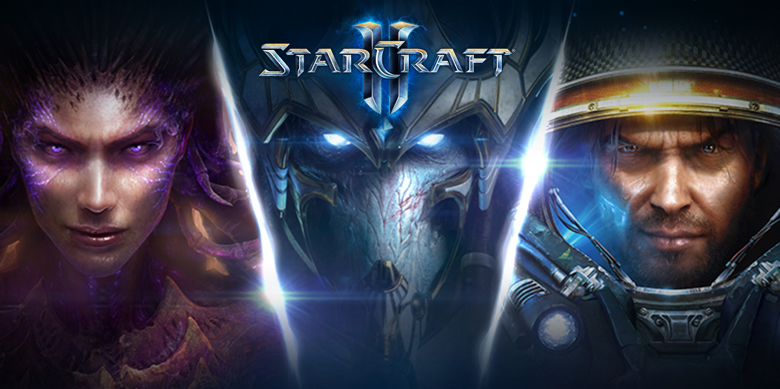

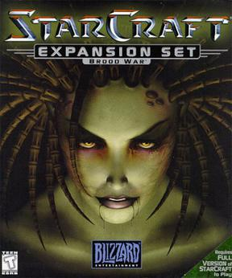
A few Answers
StarCraft II
Released in three phases: 2010, 2013, and 2015
Sequel to 1998 StarCraft original and Brood War expansion
Interstellar war between three factions
Terrans (humans)
Protoss (aliens)
Zerg (aliens)

Slide 17
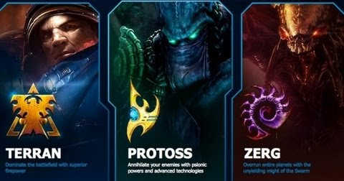
Legacy of StarCraft
StarCraft featured three wholly and distinctly unique factions with their own strengths and weaknesses
Notes:
Why did StarCraft succeed so brilliantly where other RTSs did not?

Slide 18

Terran
Strengths
Weaknesses
Mobile and adaptable
Excel at trench warfare
Tend to break when bent

Slide 19

Protoss
Strengths
Weaknesses
Hyper-advanced technology
All units have heavy shielding
Incredibly expensive

Slide 20

Zerg
Strengths
Weaknesses
Cheap units swarm and overwhelm in sheer numbers
Subtle battlefield control abilities that can shift the tide of war
Requires heavy “micromanagement”

Slide 21
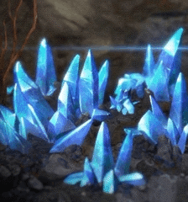

Resources
Two main resources / currencies
Minerals
Appear in “fields”
Can have lots of workers mine them simultaneously
Used for building the basic units of all three factions
Vespene gas
Must be extracted from geysers
Can only have 1 worker inside a geyser at a time
Needed for the upper-tier / advanced units of all three factions (especially Protoss)

Slide 22
Core Strategy (“Macro”)
Gather resources
Basic workers gather minerals and vespene
Construct buildings
Unlocks construction of other buildings and new units
Some buildings have defensive capabilities (turrets, pillboxes)
May include expanding to new resource locations to increase rate of income and/or seize certain strategic areas of the map
Build units
Both for defense and attack
Want a well-balanced force (air and ground)
Also want it as fast as possible and as powerful as possible (advanced units, lots of upgrades)
Attack / defend until only one player remains
Attacks can be well-planned massive sieges or fast hit-and-run raids
Wait to build up sizeable army, or attack fast (called “rushing”) and knock out opponent before they mount a defense

Slide 23
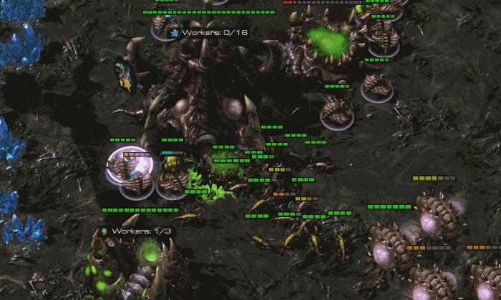
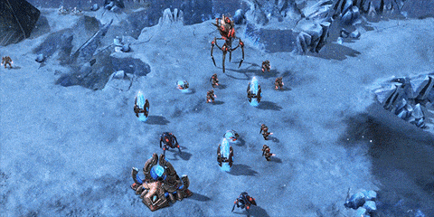
Trade-offs
Unit production
Build the less powerful unit now, or save up for the more expensive one later?
Build more units, or upgrade current ones?
Research new abilities / units or build more of current ones?
Exploration vs Exploitation
Expand to a new site (more minerals + vespene) or focus on defending current base?
Attack enemy or grow army?
Post units at strategic chokepoints on map or focus on base defense?

Slide 24
Difficulty Curve
Steep
For new players: relatively straightforward to get started
For experts: very, very long and steep climb to the top
Action space is effectively infinite
Any number of actions you could take at any moment (Build? Mine? Upgrade? Research? Scout? Attack? Defend?)
Relatively long game duration dilutes effects of reward on any specific action
1v1 games can be as quick as 2-3 minutes, but can go much longer between well-matched players
FFA (free for all) with 3+ players can last hours
Constant evaluation and re-evaluation of trade-offs
Game conditions are partially-observable (“fog of war”) so best course of action is not always clear
Often hedging one’s bets by pursuing multiple strategies, though this also dilutes effect of any one
Factions are unique, but each has a counter for any strategy the others use
Requires scouting, resource management, and prioritization to effectively counter

Slide 25
Mini Games
Google DeepMind (creators of AlphaStar StarCraft II RL bot) created SC2 “mini game” environments for narrow subtasks of SC2
Examples include:
Build Marines (basic Terran unit)
Collect minerals and gas
Defeat Roaches (pernicious Zerg unit)
Defeat Zerglings and Banelings (core of Zerg overwhelm tactics)
Move to beacon
Find and defeat Zerglings

Slide 26
Project 3
Out on Thursday, April 1 (I promise that’s not a harbinger of anything)
More details to come
In other news:
P2 peer reviews are due Tuesday, March 30
P2 Lightning Talks are on Wednesday, March 31 (same format as P1)
If anyone needs anything, please let me know

Slide 27

Questions?

Slide 28
References
Introduction to Q-Learning for Game Play https://www.youtube.com/watch?v=A3sYFcJY3lA
Keras Q-Learning in the OpenAI Gym https://www.youtube.com/watch?v=qy1SJmsRhvM
Atari Games with Keras TF-Agents https://www.youtube.com/watch?v=co0SwPWoZh0
PyTorch Reinforcement Learning DQN Tutorial https://pytorch.org/tutorials/intermediate/reinforcement_q_learning.html#dqn-algorithm

